Slide 1
Chapter 6
Distance Measures
Tables, Figures, and Equations
From: McCune, B. & J. B. Grace. 2002. Analysis of Ecological Communities. MjM Software Design, Gleneden Beach, Oregon http://www.pcord.com

Slide 2
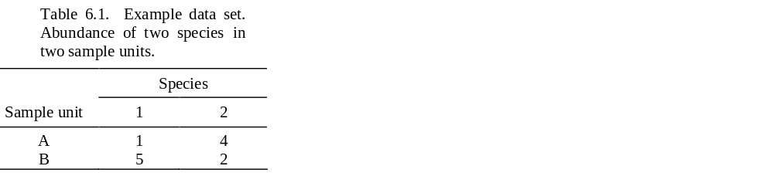
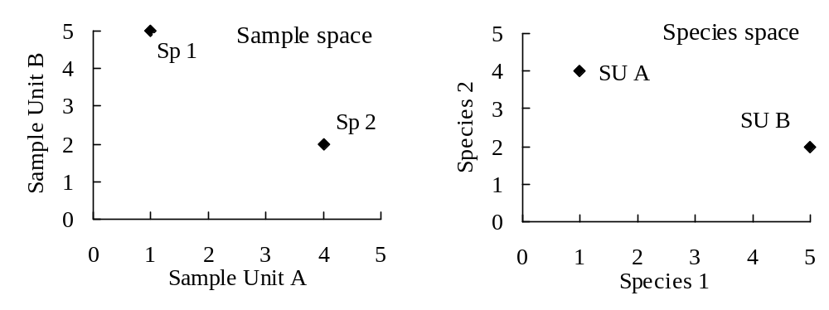
Figure 6.1. Graphical representation of the data set in Table 6.1. The left-hand graph shows species as points in sample space. The right-hand graph shows sample units as points in species space.

Slide 3
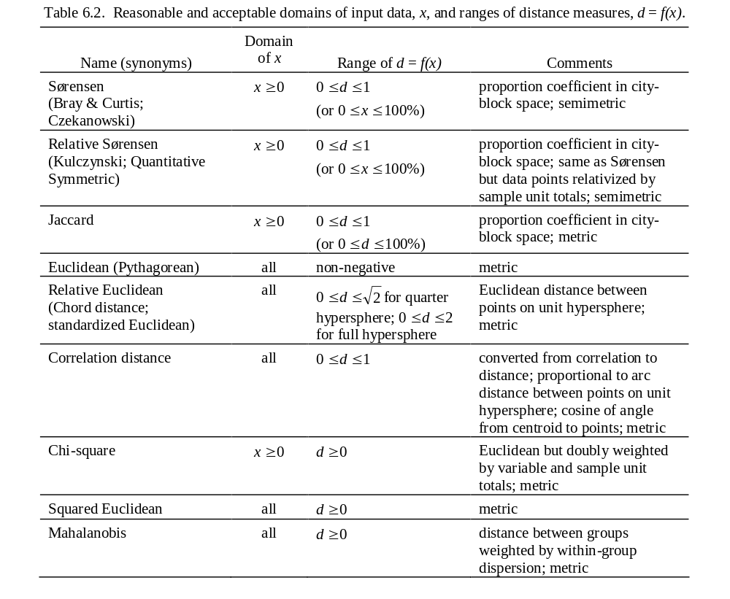

Slide 4
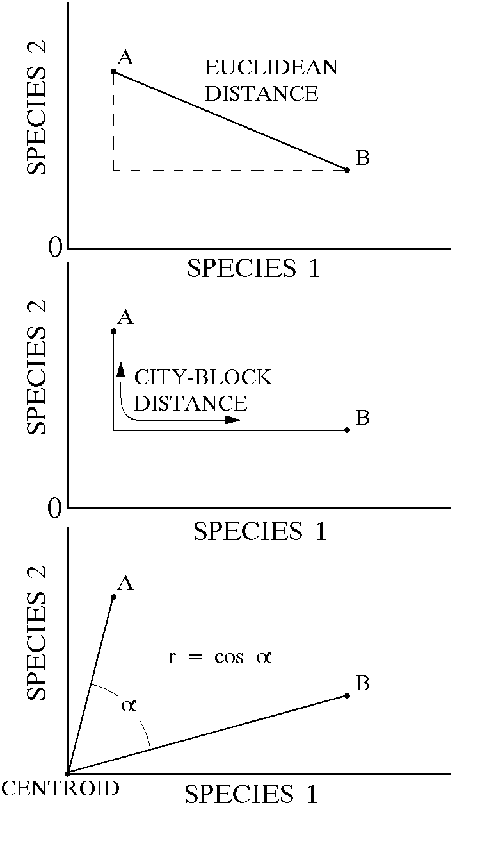
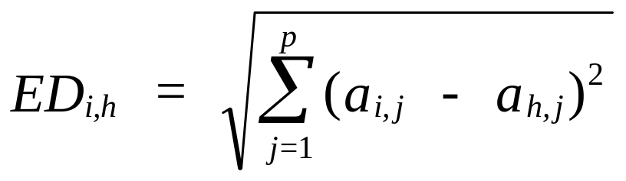
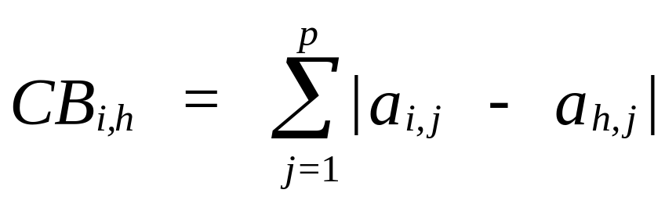
      Euclidean distance
City-block distance (= Manhattan distance)
Figure 6.2. Geometric representations of basic distance measures between two sample units (A and B) in species space. In the upper two graphs the axes meet at the origin; in the lowest graph, at the centroid.

Slide 5
      Euclidean distance
City-block distance (= Manhattan distance)
Figure 6.2. Geometric representations of basic distance measures between two sample units (A and B) in species space. In the upper two graphs the axes meet at the origin; in the lowest graph, at the centroid.

Slide 6
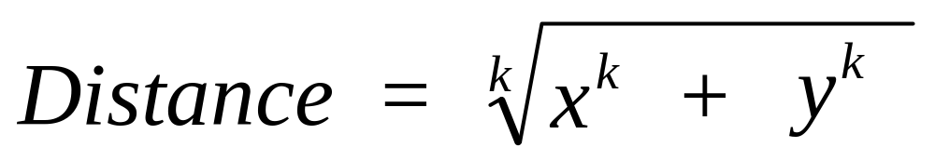
Minkowski metric in two dimensions:
k = 2 gives Euclidean distance
k = 1 gives city-block distance

Slide 7
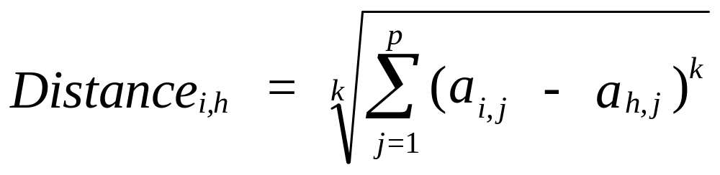
Minkowski metric in two dimensions:
Minkowski metric in p dimensions:
k = 2 gives Euclidean distance
k = 1 gives city-block distance

Slide 8
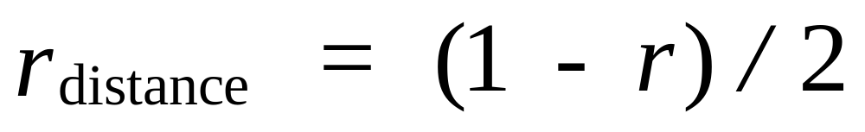
The correlation coefficient can be rescaled to a distance measure of range 0-1 by:

Slide 9
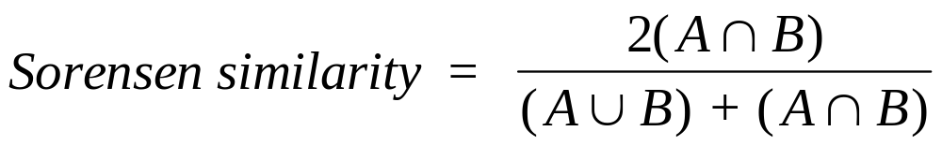
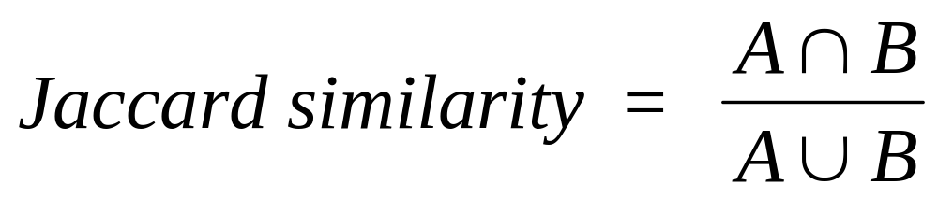
Proportion coefficients

Slide 10
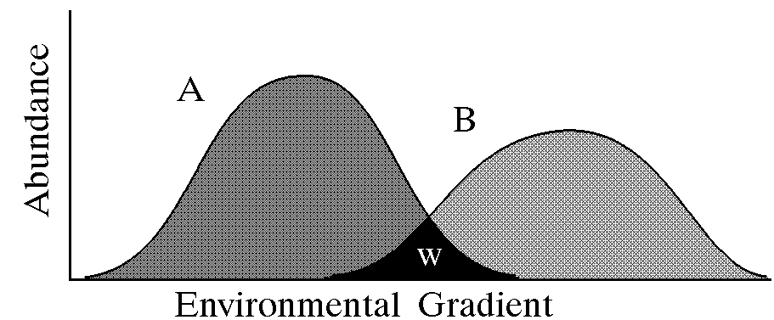
Figure 6.3. Overlap between two species abundances along an environmental gradient. The abundance shared between species A and B is shown by w.

Slide 11
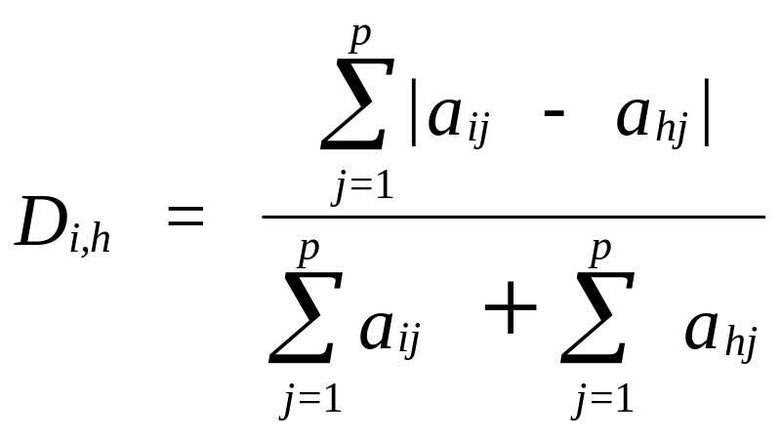
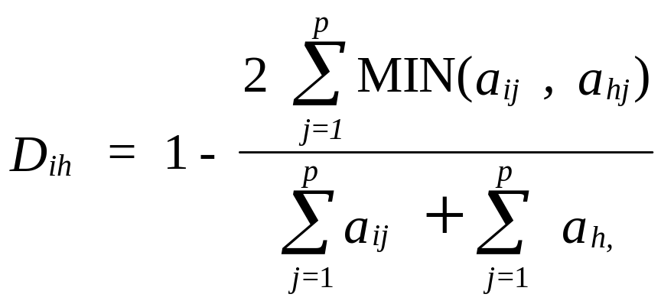

Slide 12
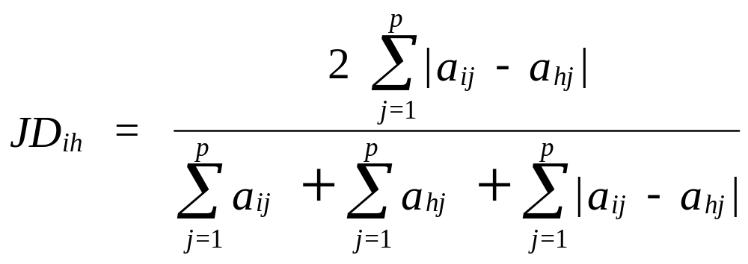
Jaccard dissimilarity is the proportion of the combined abundance that is not shared, or w / (A + B - w) (Jaccard 1901):

Slide 13
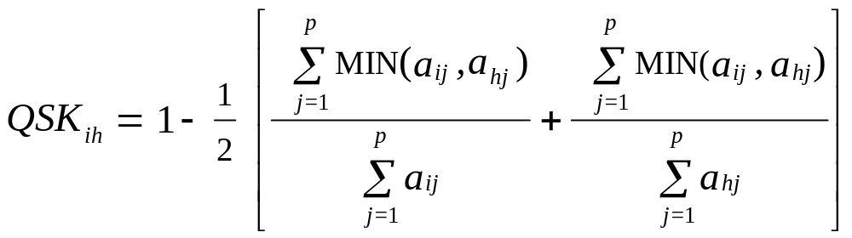
Quantitative symmetric dissimilarity (also known as the Kulczynski or QSK coefficient; see Faith et al. 1987):

Slide 14
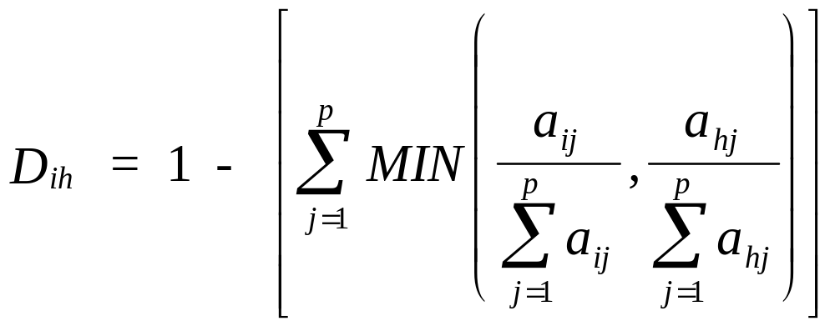
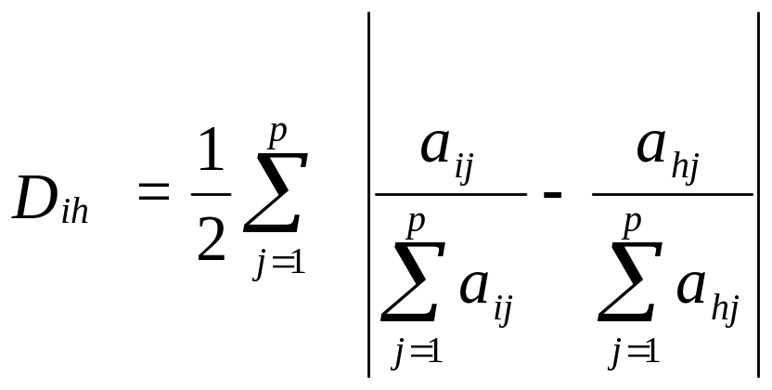
Relative Sørensen (also known as relativized Manhattan coefficient in Faith et al. 1987) is mathematically equivalent to the Bray-Curtis coefficient on data relativized by SU total:
or:

Slide 15
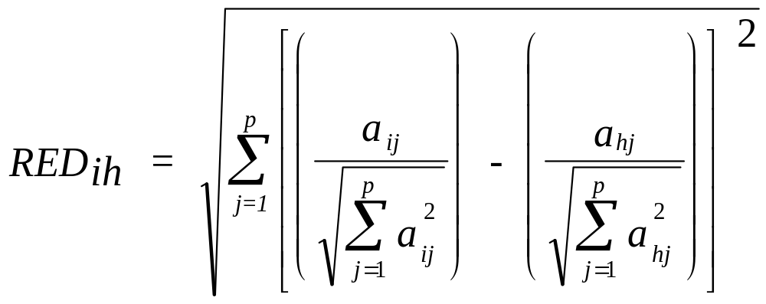
      Relative Euclidean distance (RED)

Slide 16
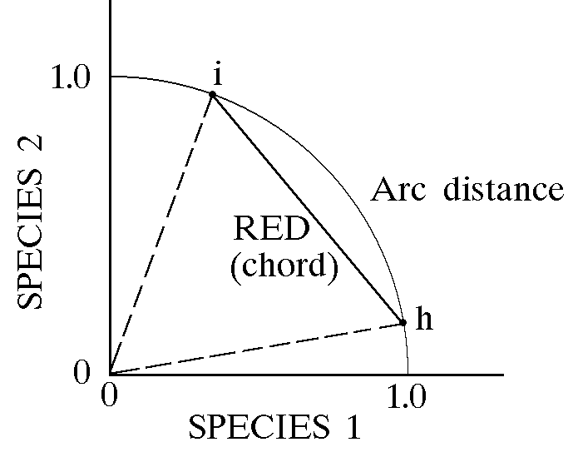
Figure 6.4. Relative Euclidean distance is the chord distance between two points on the surface of a unit hypersphere.

Slide 17
r = cos θ
= arccos (r)
θ
Figure 6.4. Relative Euclidean distance is the chord distance between two points on the surface of a unit hypersphere.

Slide 18
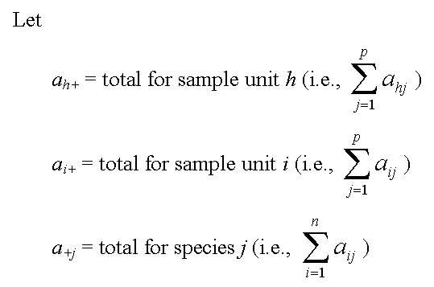
Some notation...

Slide 19
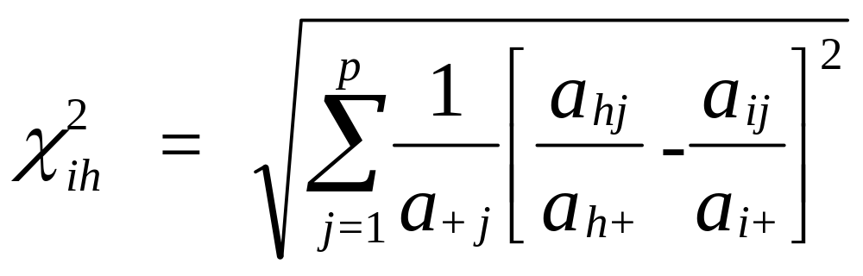
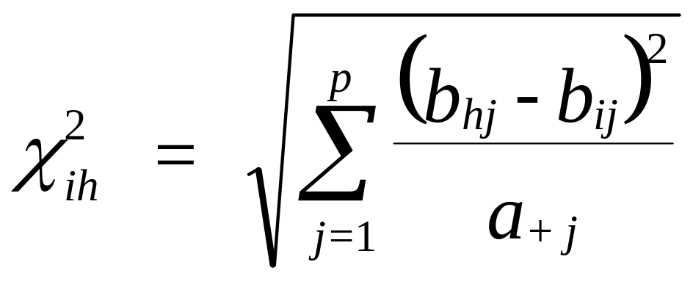
then the chi-square distance (Chardy et al. 1976) is:
If the data are prerelativized by sample unit totals (i.e., b_{ij} = a_{ij} /a_{i+}), then the equation simplifies to:

Slide 20
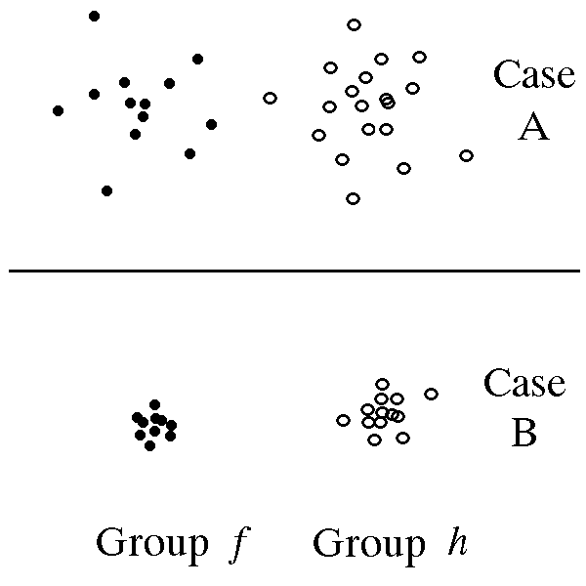
Figure 6.5. Illustration of the influence of within-group variance on Mahalanobis distance.

Slide 21
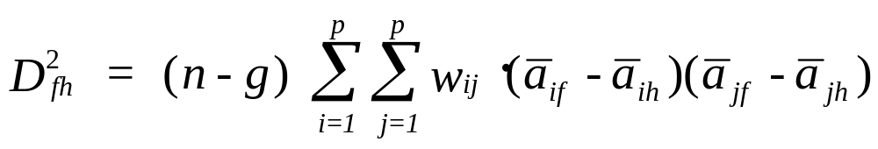
Mahalanobis distance D_{fh}² is used as a distance measure between two groups (f and h).
where
  a_{if} is the mean for ith variable in group f
  w_{ij} is an element from the inverse of the pooled within groups covariance matrix (downweights correlated variables)
  n is the number of sample units,
  g is the number of groups, and
  i ≠ j.

Slide 22
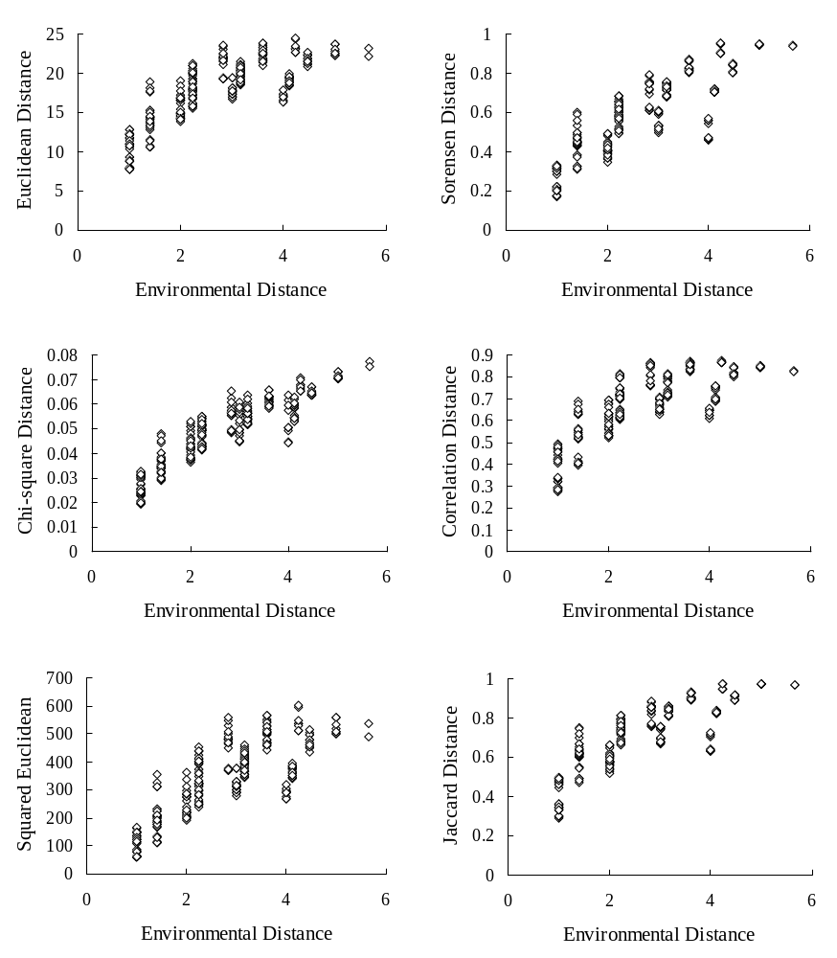
Figure 6.6. Relationship between distance in species space for an easy data set, using various distance measures, and environmental distance. The graphs are based on a synthetic data set with noiseless species responses to two known underlying environmental gradients. The gradients were sampled with a 5 × 5 grid. This is an “easy” data set because the average distance is reasonably small (Sørensen distance = 0.59; 1.3 half changes) all species are similar in abundance (CV of species totals = 37%) and sample units have similar totals (CV of SU totals = 17%).

Slide 23
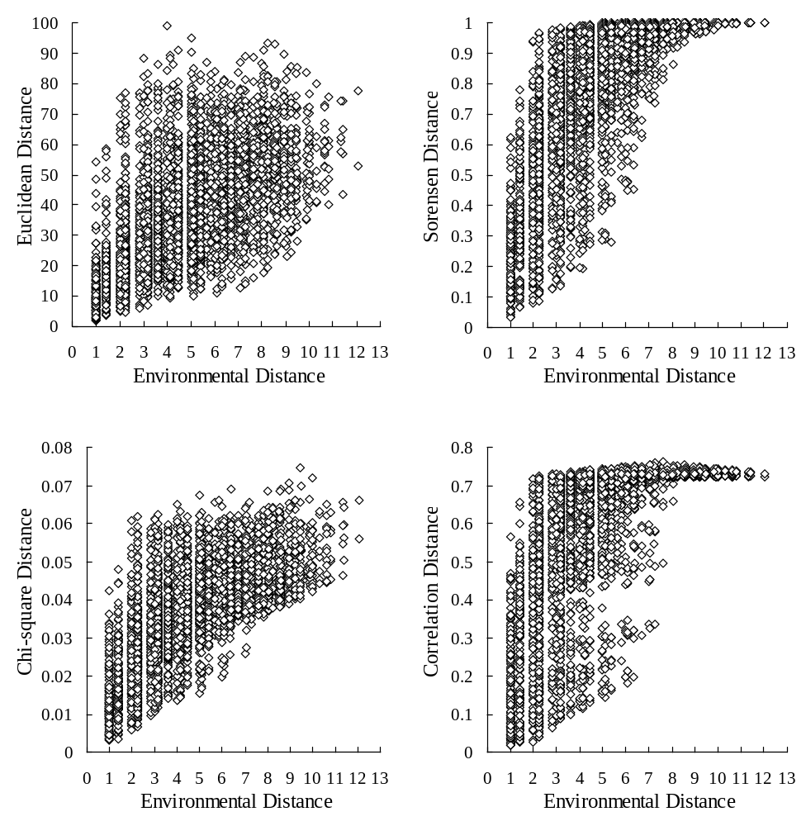
Figure 6.7. Relationship between distance in species space for a more difficult data set, using various distance measures, and environmental distance. The graphs are based on a synthetic data set with noiseless species responses to two known underlying environmental gradients. The gradients were sampled with a 10 × 10 grid. This is a “more difficult” data set because the average distance is rather large (Sørensen distance = 0.79; 2.3 half changes), species vary in abundance (CV of species totals = 183%), and sample units have moderately variable totals (CV of SU totals = 40%).

Slide 24
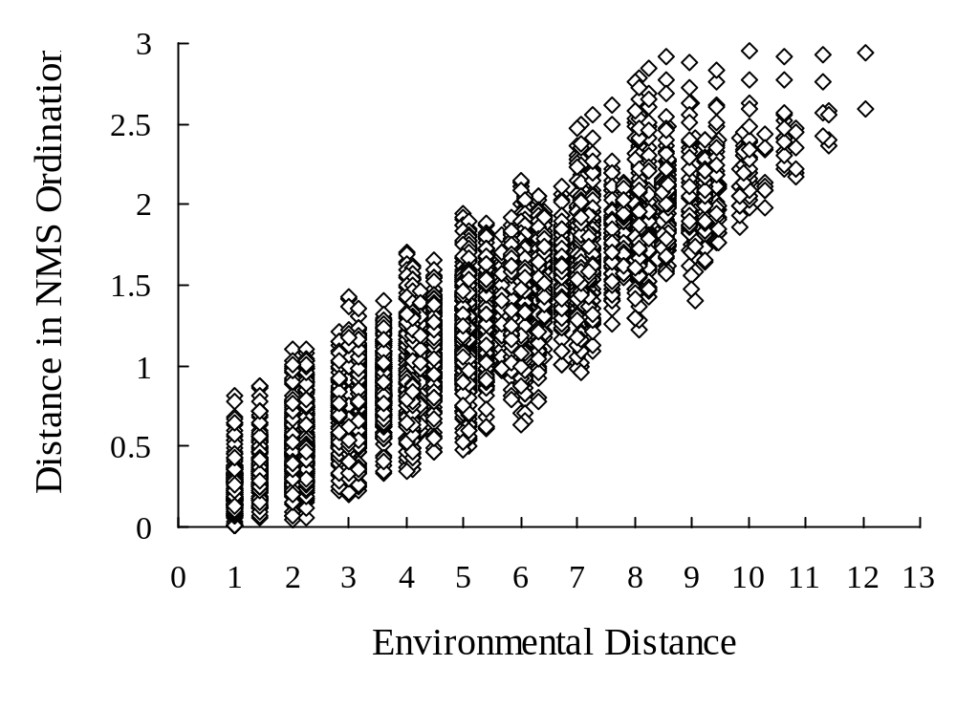
Figure 6.8. Distance in a 2-D nonmetric multidimensional scaling ordination (NMS) in relation to environmental distances, using the same data set as in Figure 6.7. Note how the ordination overcame the limita- tion of the Sørensen coefficient at expressing large distances.

Slide 25
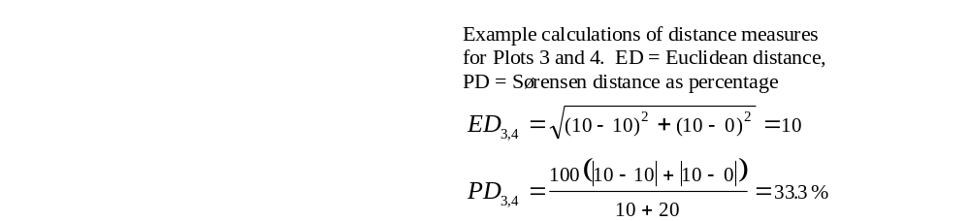
Box 6.1. Comparison of Euclidean distance with a proportion coefficient (Sørensen distance). Relative proportions of species 1 and 2 are the same between Plots 1 and 2 and Plots 3 and 4.
Data matrix containing abundances
of two species in four plots.
Sp1 Sp2
Plot 1 1 0
Plot 2 1 1
Plot 3 10 0
Plot 4 10 10

Slide 26
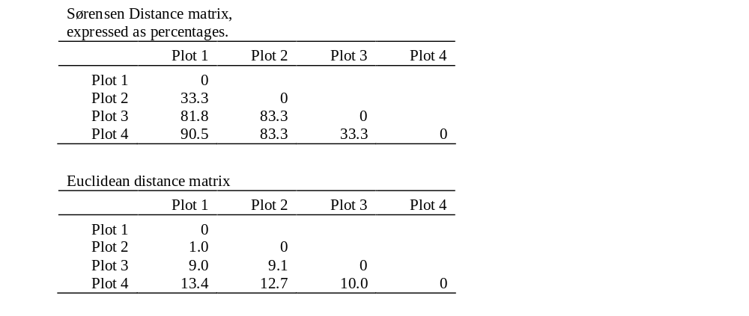

Slide 27
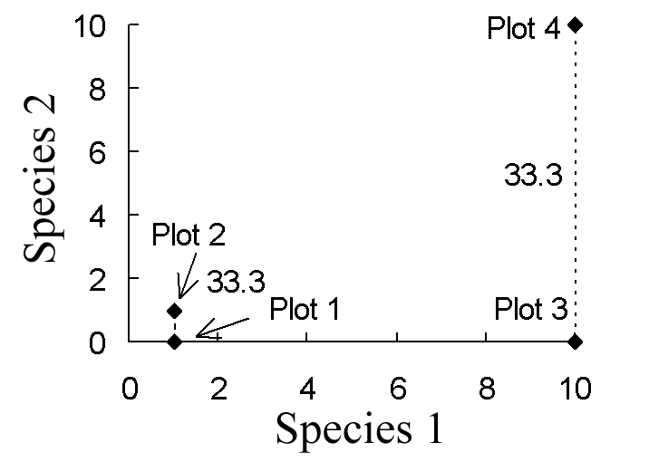
  The Sørensen distance between Plots 1 and 2 is 0.333 (33.3%), as is the Sørensen distance between Plots 3 and 4, as illustrated below. In both cases the shared abundance is one third of the total abundance. In contrast, the Euclidean distance between Plots 1 and 2 is 1, while the Euclidean distance between Plots 3 and 4 is 10. Thus the Sørensen coefficient expresses the shared abundance as a proportion of the total abundance, while Euclidean distance is unconcerned with proportions.

Slide 28

  Box 6.2. Example data set comparing Euclidean and city-block distances, contrasting the effect of squaring differences versus not.
  Hypothetical data: abundance of four species in three sample units (SU).
  Sample units A,B: species differences d = 1, 1, 1, 9 for each of the four species.
Sample units A,C: species differences d = 3, 3, 3, 3

Slide 29

  Sample units A,B: species differences d = 1, 1, 1, 9 for each of the four species.
Sample units A,C: species differences d = 3, 3, 3, 3
Which distance measure matches your intuition?

